Slide 1
Algorithm Analysis I
CSCI 2010U - Data Structures

Slide 2
Outline
Math review
Summation
Exponents
Logarithms
Induction
Running time
Best, average, and worst case
Measured running time
Number of primitive operations
Space requirements
Object-Oriented Programming
2

Slide 3
Math Review

Slide 4




Summation
Summation rules
Object-Oriented Programming
4

Slide 5
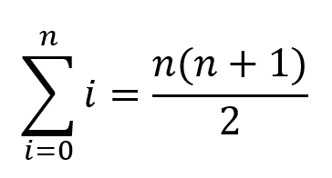
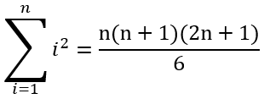
Summation
Some well-known sums:
Object-Oriented Programming
5

Slide 6
Exponents
Exponent rules:
a^{(b+c)} = a^{b}a ^{c}
a^{(b-c)} = a^{b} /a^{c}
a^{bc} = (a^{b})^{c}
Object-Oriented Programming
6

Slide 7
Logarithms
Logarithm rules:
log_{b}(xy) = log_{b}x + log_{b}y
log_{b}(x/y) = log_{b}x - log_{b}y
log_{b}(xª) = alog_{b}x
log_{b}a = log_{x}a/log_{x}b
Object-Oriented Programming
7

Slide 8
Induction

Slide 9
Induction
Induction is a proof technique commonly used in Computer Science
Consider this example:
You have an ideal robot
A basically unlimited power source, no faults, etc.
You want to prove that the robot can make it to the top of a pyramid
The steps of the pyramid are very consistent height and shape
Your proof would look like this:
Prove that the robot can make it to the bottom step (base step)
Prove that, assuming the robot can somehow make it to step k, than it can make it up to step k + 1 (inductive step)
Object-Oriented Programming
9

Slide 10
Induction
The intuition for this inductive proof is that:
Your robot can make it to the first step, step 0 (base step)
Your robot is on step 0, and thus can make it to step 1 (inductive step)
Your robot is on step 1, and thus can make it to step 2 (inductive step again)
Your robot is on step 2, and thus can make it to step 3 (inductive step again)
Your robot is on step 3, and thus can make it to step 4 (inductive step again)
etc.
Object-Oriented Programming
10
Notes:
Using these two steps, we can prove that the robot can climb to any finite step. To prove the robot can get to the 100th step, instead of having the robot climb 100 steps, we test if it can climb just one.
For infinite proofs, this is especially useful.

Slide 11
Activity
Use induction to prove the following summation rule:
Object-Oriented Programming
11

Slide 12
Activity
Let's use induction to prove the following summation rule:
Object-Oriented Programming
12

Slide 13
Running Time

Slide 14
Running Time
Running time is a general term that describes how much time an algorithm takes to execute
Running time is usually represented with T(n)
n - the size of the input (e.g. list length, fibonacci index)
Some algorithms have multiple input types (e.g. matrix length and width)
e.g. T(n,m)
Object-Oriented Programming
14
Notes:
As you may have guessed from the lecture title, our goal is the analytic approach, but first we'll need to build some foundations. We'll start with the empirical approach, which isn't perfect.

Slide 15
Running Time
Techniques for determining running time:
Empirical: measure the time it takes to run
Analytic: find a function that represents its growth as n increases
Object-Oriented Programming
15
Notes:
As you may have guessed from the lecture title, our goal is the analytic approach, but first we'll need to build some foundations. We'll start with the empirical approach, which isn't perfect.

Slide 16
Running Time
In general, we care about three different running times:
Best case - circumstances that lead to the fastest execution (not that useful)
e.g. finding the element at the start of the list
Average case - weighted average of the running time over all possible outcomes (most useful, most difficult to determine)
Worst case - circumstances that lead to the slowest execution (useful as an upper bound)
e.g. not finding the element anywhere in the list
Object-Oriented Programming
16

Slide 17
Measuring Running Time
Most programming languages have a way to determine the precise time
Measure the time before and after the operation, and find the difference:
double startTime = (double)System.nanoTime();
index = linearSearch(values, toFind);
double endTime = (double)System.nanoTime();
double duration = endTime - startTime;
Analysis of Algorithms
17

Slide 18
Limitations of the Empirical Approach
Results may not be indicative of the running time on other inputs not included in the experiment
In order to compare two algorithms, the same hardware and software environments must be used
Even on the same hardware, with multi-tasking operating systems, your computer could be interrupted (e.g. updates)
An analysis should be independent of any hardware or software environment
Analysis of Algorithms
18

Slide 19
Measuring Running Time - Linear Search
Let's use this technique to measure the best, worst, and average case performance of linear search
public static int linearSearch(int[] values, int toFind) {
for (int i = 0; i < values.length; i++) { # How many iterations?
if (values[i] == toFind) {
return i;
}
}
return -1;
}
Analysis of Algorithms
19
Notes:
Average case analysis involves an amortized analysis (similar to expected value in probability).
Often ignored is the best case complexity.

Slide 20
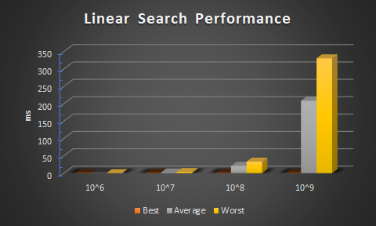
Measuring Running Time - Linear Search
As the number of elements in the list, n, increases by a factor of 10, so does the time it takes to perform a linear search (for average and worst case)
n | Best | Average | Worst
10⁶ | 0.001694 | 0.162575 | 0.242308
10⁷ | 0.000031 | 2.024319 | 3.311671
10⁸ | 0.000036 | 21.060701 | 33.226955
10⁹ | 0.000033 | 208.743678 | 330.672545
Analysis of Algorithms
20
Notes:
The trend does not seem to be the same for best case.
This is where linear search gets its name. The time it takes increases linearly with the input size.

Slide 21
Measuring Running Time - Linear Search
The case where the worst-case performance and the average case performance have roughly the same growth pattern is quite common
Average case analysis can be quite challenging to do (on typical algorithms, not simple ones like linear search)
It may be sufficient to know the worst case performance
Analysis of Algorithms
21

Slide 22
Measuring Running Time - Binary Search
Let's use this technique to measure the running time of binary search
public static int binarySearch(int[] values, int toFind, int startIndex, int endIndex) {
if (endIndex < startIndex)
return -1; // not found
int mid = (startIndex + endIndex) / 2;
if (toFind == values[mid]) {
return mid;
} else if (toFind < values[mid]) {
return binarySearch(values, toFind, startIndex, mid - 1);
} else {
return binarySearch(values, toFind, mid + 1, endIndex);
}
}
Analysis of Algorithms
22

Slide 23
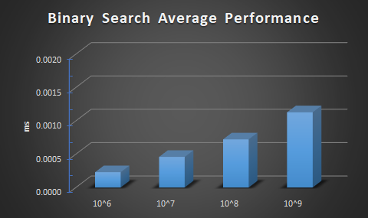
Measuring Running Time - Binary Search
As the number of elements in the list, n, increases by a factor of 10, the time it takes to perform a binary search increases linearly
n | Average
10⁶ | 0.00023
10⁷ | 0.000459
10⁸ | 0.000722
10⁹ | 0.001128
Analysis of Algorithms
23

Slide 24
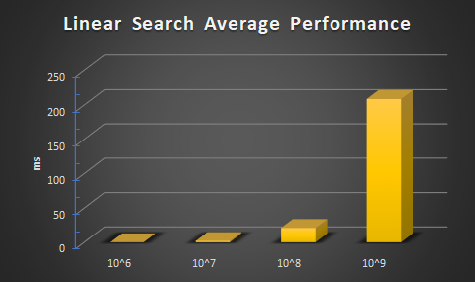
Linear Search vs. Binary Search
Analysis of Algorithms
24
Notes:
Notice the y-axis in these graphs. Binary search uses far fewer operations for the same input size, especially so as n increases.

Slide 25
Space Requirements

Slide 26
Space Requirements
Much like running time, we might also care about how much space (e.g. in RAM) an algorithm requires while executing
Space requirements are usually represented with S(n)
We may care about the best, average, and worst case space requirements
We may count address spaces, much like we count primitive operations
What good is a high-performance algorithm if we can't run it because it uses too much RAM?
Analysis of Algorithms
26
Notes:
One aspect of RAM that is often forgotten is the space required to call a function, particularly in recursive algorithms with high recursion depth.

Slide 27
Wrap-up
Math review
Summation
Exponents
Logarithms
Induction
Running time
Best, average, and worst case
Measured running time
Number of primitive operations
Space requirements
Object-Oriented Programming
27

